Slide 1

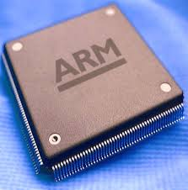
Microprocessor & Computer Architecture
UE18CS253
Session – 4 & 5
ARM
Assembly Language Programming
Credits:
MPCA Team
SESSION JAN-MAY 2020
1
Notes:
1

Slide 2
The ARM
Flow control Instructions
SESSION JAN-MAY 2020
2

Slide 3
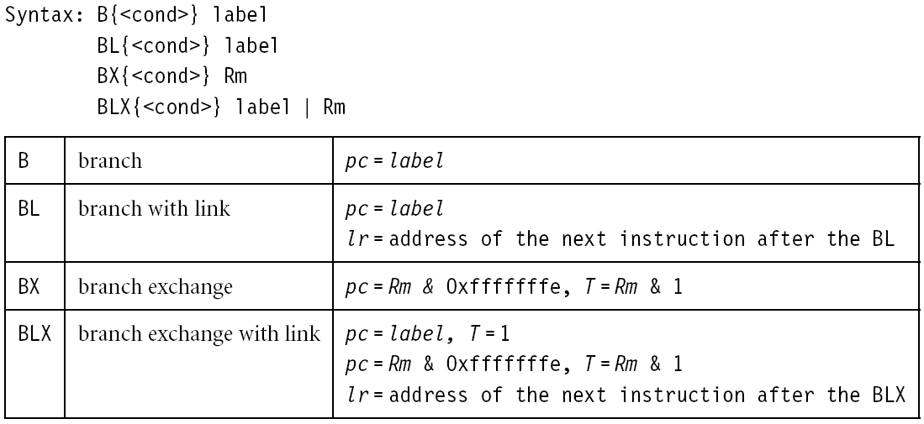
Flow control instructions
Determine the instruction to be executed next
pc-relative offset within 32MB
SESSION JAN-MAY 2020
3
Notes:
3

Slide 4
Flow control instructions
Branch instruction
B label
…
label: …
Conditional branches
MOV R0, #0
loop: …
ADD R0, R0, #1
CMP R0, #10
BNE loop
SESSION JAN-MAY 2020
4

Slide 5
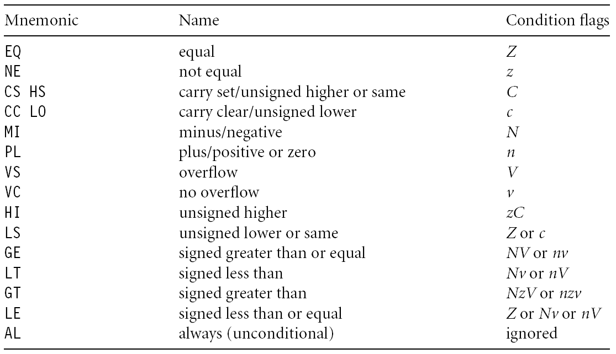
Branch conditions
SESSION JAN-MAY 2020
5

Slide 6
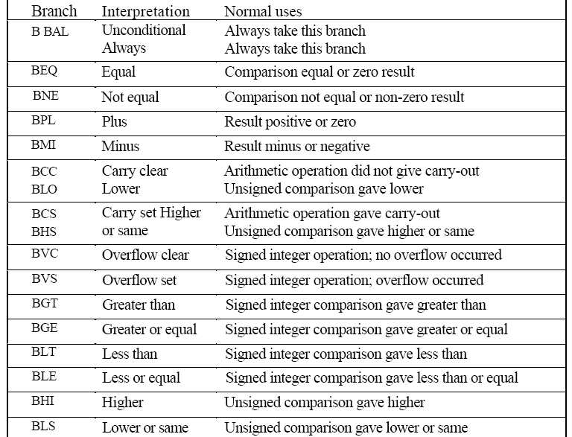
Branches
SESSION JAN-MAY 2020
6

Slide 7
Branch and link
BL instruction save the return address to R14 (lr)
BL sub @ call sub
CMP R1, #5 @ return to here
MOVEQ R1, #0
…
sub: … @ sub entry point
…
MOV PC, LR @ return
SESSION JAN-MAY 2020
7

Slide 8
The ARM
Data Transfer Instruction Set
SESSION JAN-MAY 2020
8

Slide 9
Data transfer instructions
Move data between registers and memory
Basic forms
Single register load/store
Ex: LDR , STR
Multiple register load/store
Ex: LDM, STM
SESSION JAN-MAY 2020
9

Slide 10
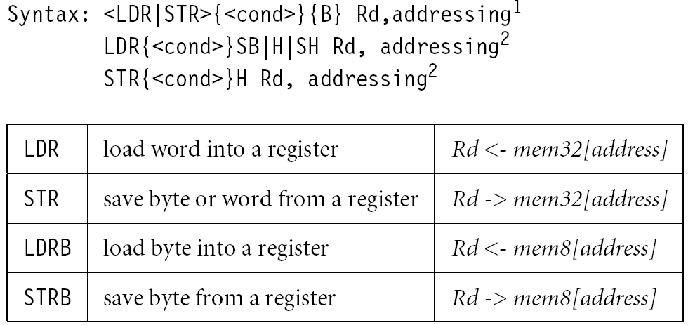
Single register load/store
CODE
SESSION JAN-MAY 2020
10

Slide 11
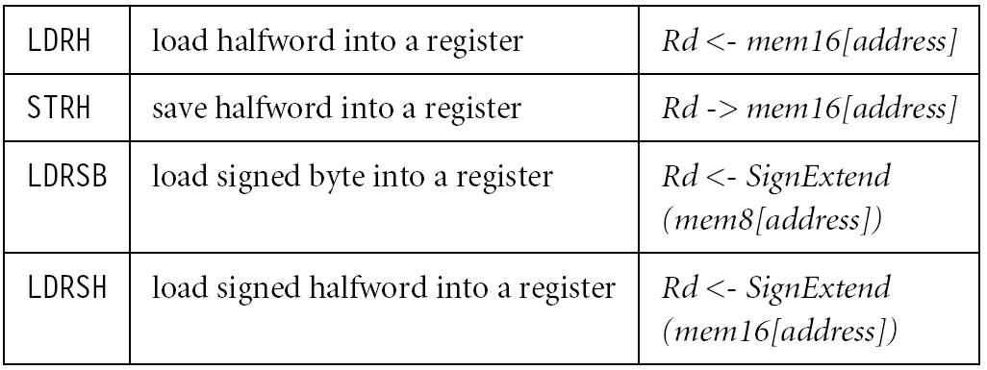
Single register load/store
CODE
No STRSB/STRSH since STRB/STRH stores both
signed/unsigned ones
SESSION JAN-MAY 2020
11

Slide 12
Single register load/store
CODE
The data items can be a 8-bit byte, 16-bit half-word or 32-bit word. Addresses must be boundary aligned. (e.g. 4’s multiple for LDR/STR)
LDR R0, [R1] @ R0 := mem₃₂[R1]
STR R0, [R1] @ mem₃₂[R1] := R0
LDR, LDRH, LDRB for 32, 16, 8 bits
STR, STRH, STRB for 32, 16, 8 bits
SESSION JAN-MAY 2020
12

Slide 13
Addressing modes
CODE
Memory is addressed by a register and an offset.
LDR R0, [R1] @ mem[R1]
Three ways to specify offsets:
Immediate
LDR R0, [R1, #4] @ mem[R1+4]
Register
LDR R0, [R1, R2] @ mem[R1+R2]
Scaled register
@ mem[R1+4*R2]
LDR R0, [R1, R2, LSL #2]
SESSION JAN-MAY 2020
13
Notes:
13

Slide 14
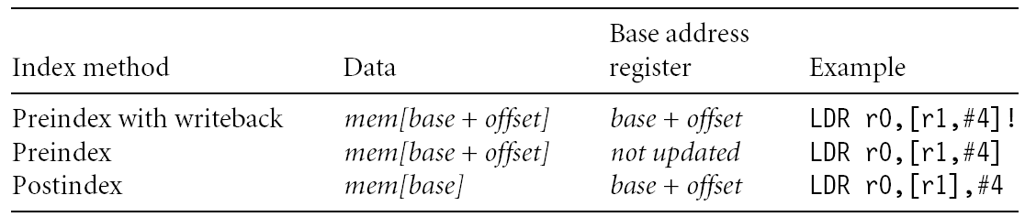
Addressing modes
Pre-index addressing (LDR R0, [R1, #4]) without a writeback
Auto-indexing addressing (LDR R0, [R1, #4]!)
Pre-index with writeback calculation before accessing with a writeback
Post-index addressing (LDR R0, [R1], #4)
calculation after accessing with a writeback
SESSION JAN-MAY 2020
14
Notes:
14

Slide 15
Pre-index addressing
LDR R0, [R1, #4] @ R0=mem[R1+4]
@ R1 unchanged
LDR R0, [R1, ]
R1
+
R0
SESSION JAN-MAY 2020
15
Notes:
15

Slide 16
Auto-indexing addressing
LDR R0, [R1, #4]! @ R0=mem[R1+4]
@ R1=R1+4
No extra time; Fast;
LDR R0, [R1, ]!
R1
+
R0
SESSION JAN-MAY 2020
16
Notes:
16

Slide 17
Post-index addressing
LDR R0, [R1], #4 @ R0=mem[R1]
@ R1=R1+4
LDR R0,[R1],
R1
R0
+
SESSION JAN-MAY 2020
17
Notes:
17

Slide 18
Comparisons
Pre-indexed addressing
LDR R0, [R1, R2] @ R0=mem[R1+R2]
@ R1 unchanged
Auto-indexing addressing
LDR R0, [R1, R2]! @ R0=mem[R1+R2]
@ R1=R1+R2
Post-indexed addressing
LDR R0, [R1], R2 @ R0=mem[R1]
@ R1=R1+R2
SESSION JAN-MAY 2020
18
Notes:
18

Slide 19
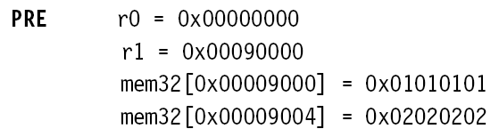

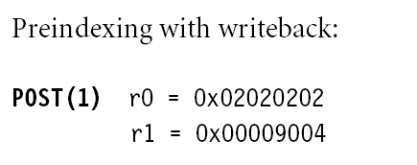
Example
SESSION JAN-MAY 2020
19

Slide 20

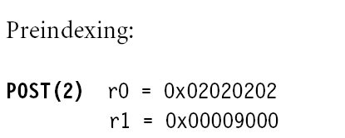
Example
SESSION JAN-MAY 2020
20
Notes:
20

Slide 21

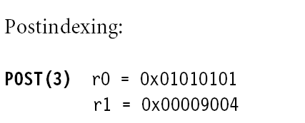
Example
SESSION JAN-MAY 2020
21

Slide 22
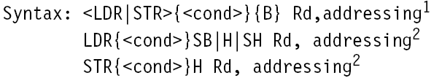
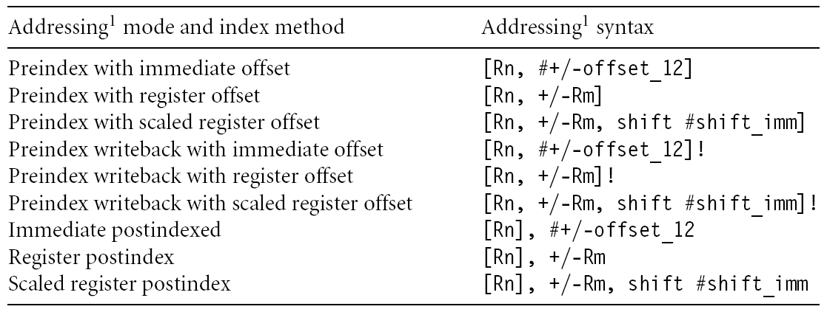
Summary of addressing modes
SESSION JAN-MAY 2020
22

Slide 23
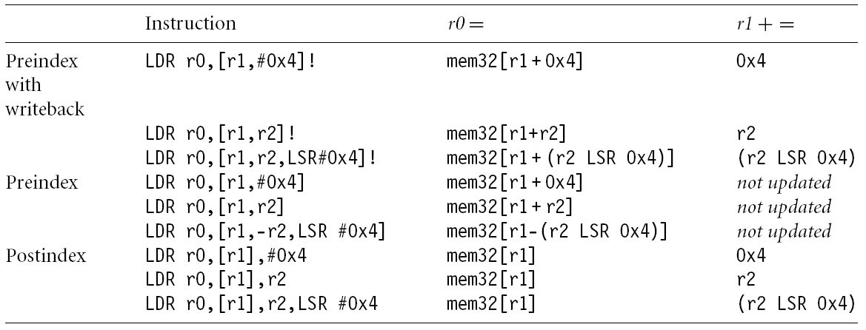
Summary of addressing modes
SESSION JAN-MAY 2020
23

Slide 24
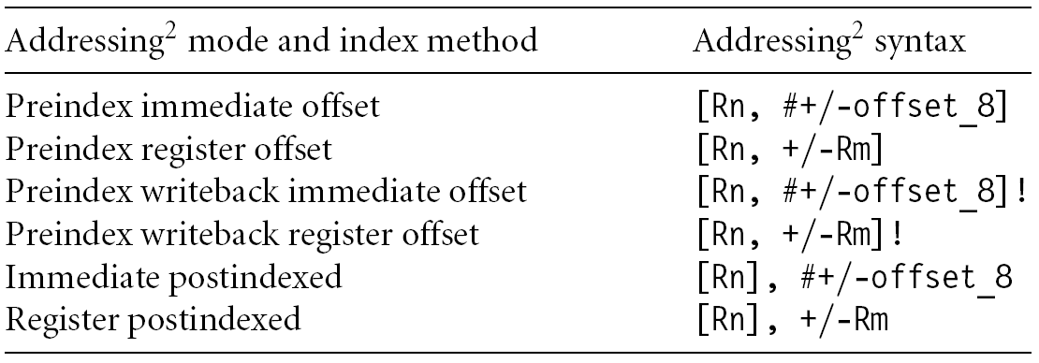
Summary of addressing modes
SESSION JAN-MAY 2020
24

Slide 25
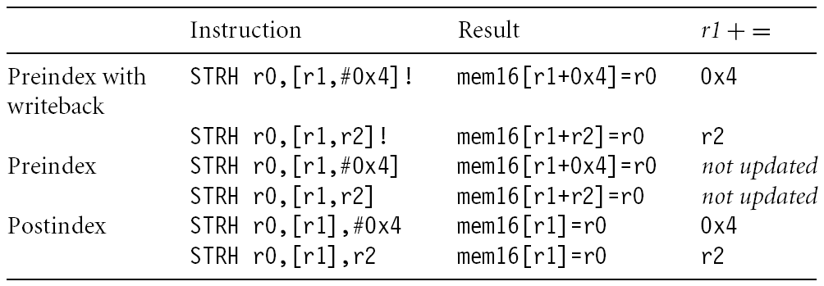
Summary of addressing modes
SESSION JAN-MAY 2020
25

Slide 26
Load an address into a register
Note that all addressing modes are register-offsetted. Can we issue LDR R0, Table? The pseudo instruction ADR loads a register with an address
table: .word 10
…
LDR R0, table
Assembler transfer pseudo instruction into a sequence of appropriate instructions
sub r0, pc, #12
SESSION JAN-MAY 2020
26

Slide 27
Application
ADR R1, table
loop: LDR R0, [R1]
ADD R1, R1, #4
@ operations on R0
…
ADR R1, table
loop: LDR R0, [R1], #4
@ operations on R0
…
table
R1
SESSION JAN-MAY 2020
27

Slide 28
Q & A on Arm Instruction Set – Data Transfer group
SESSION JAN-MAY 2020
28

